Slide 1
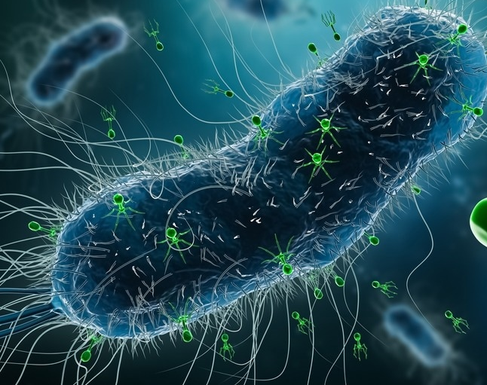
PhageMatch
The Algorithm Behind the Cure.

Slide 2
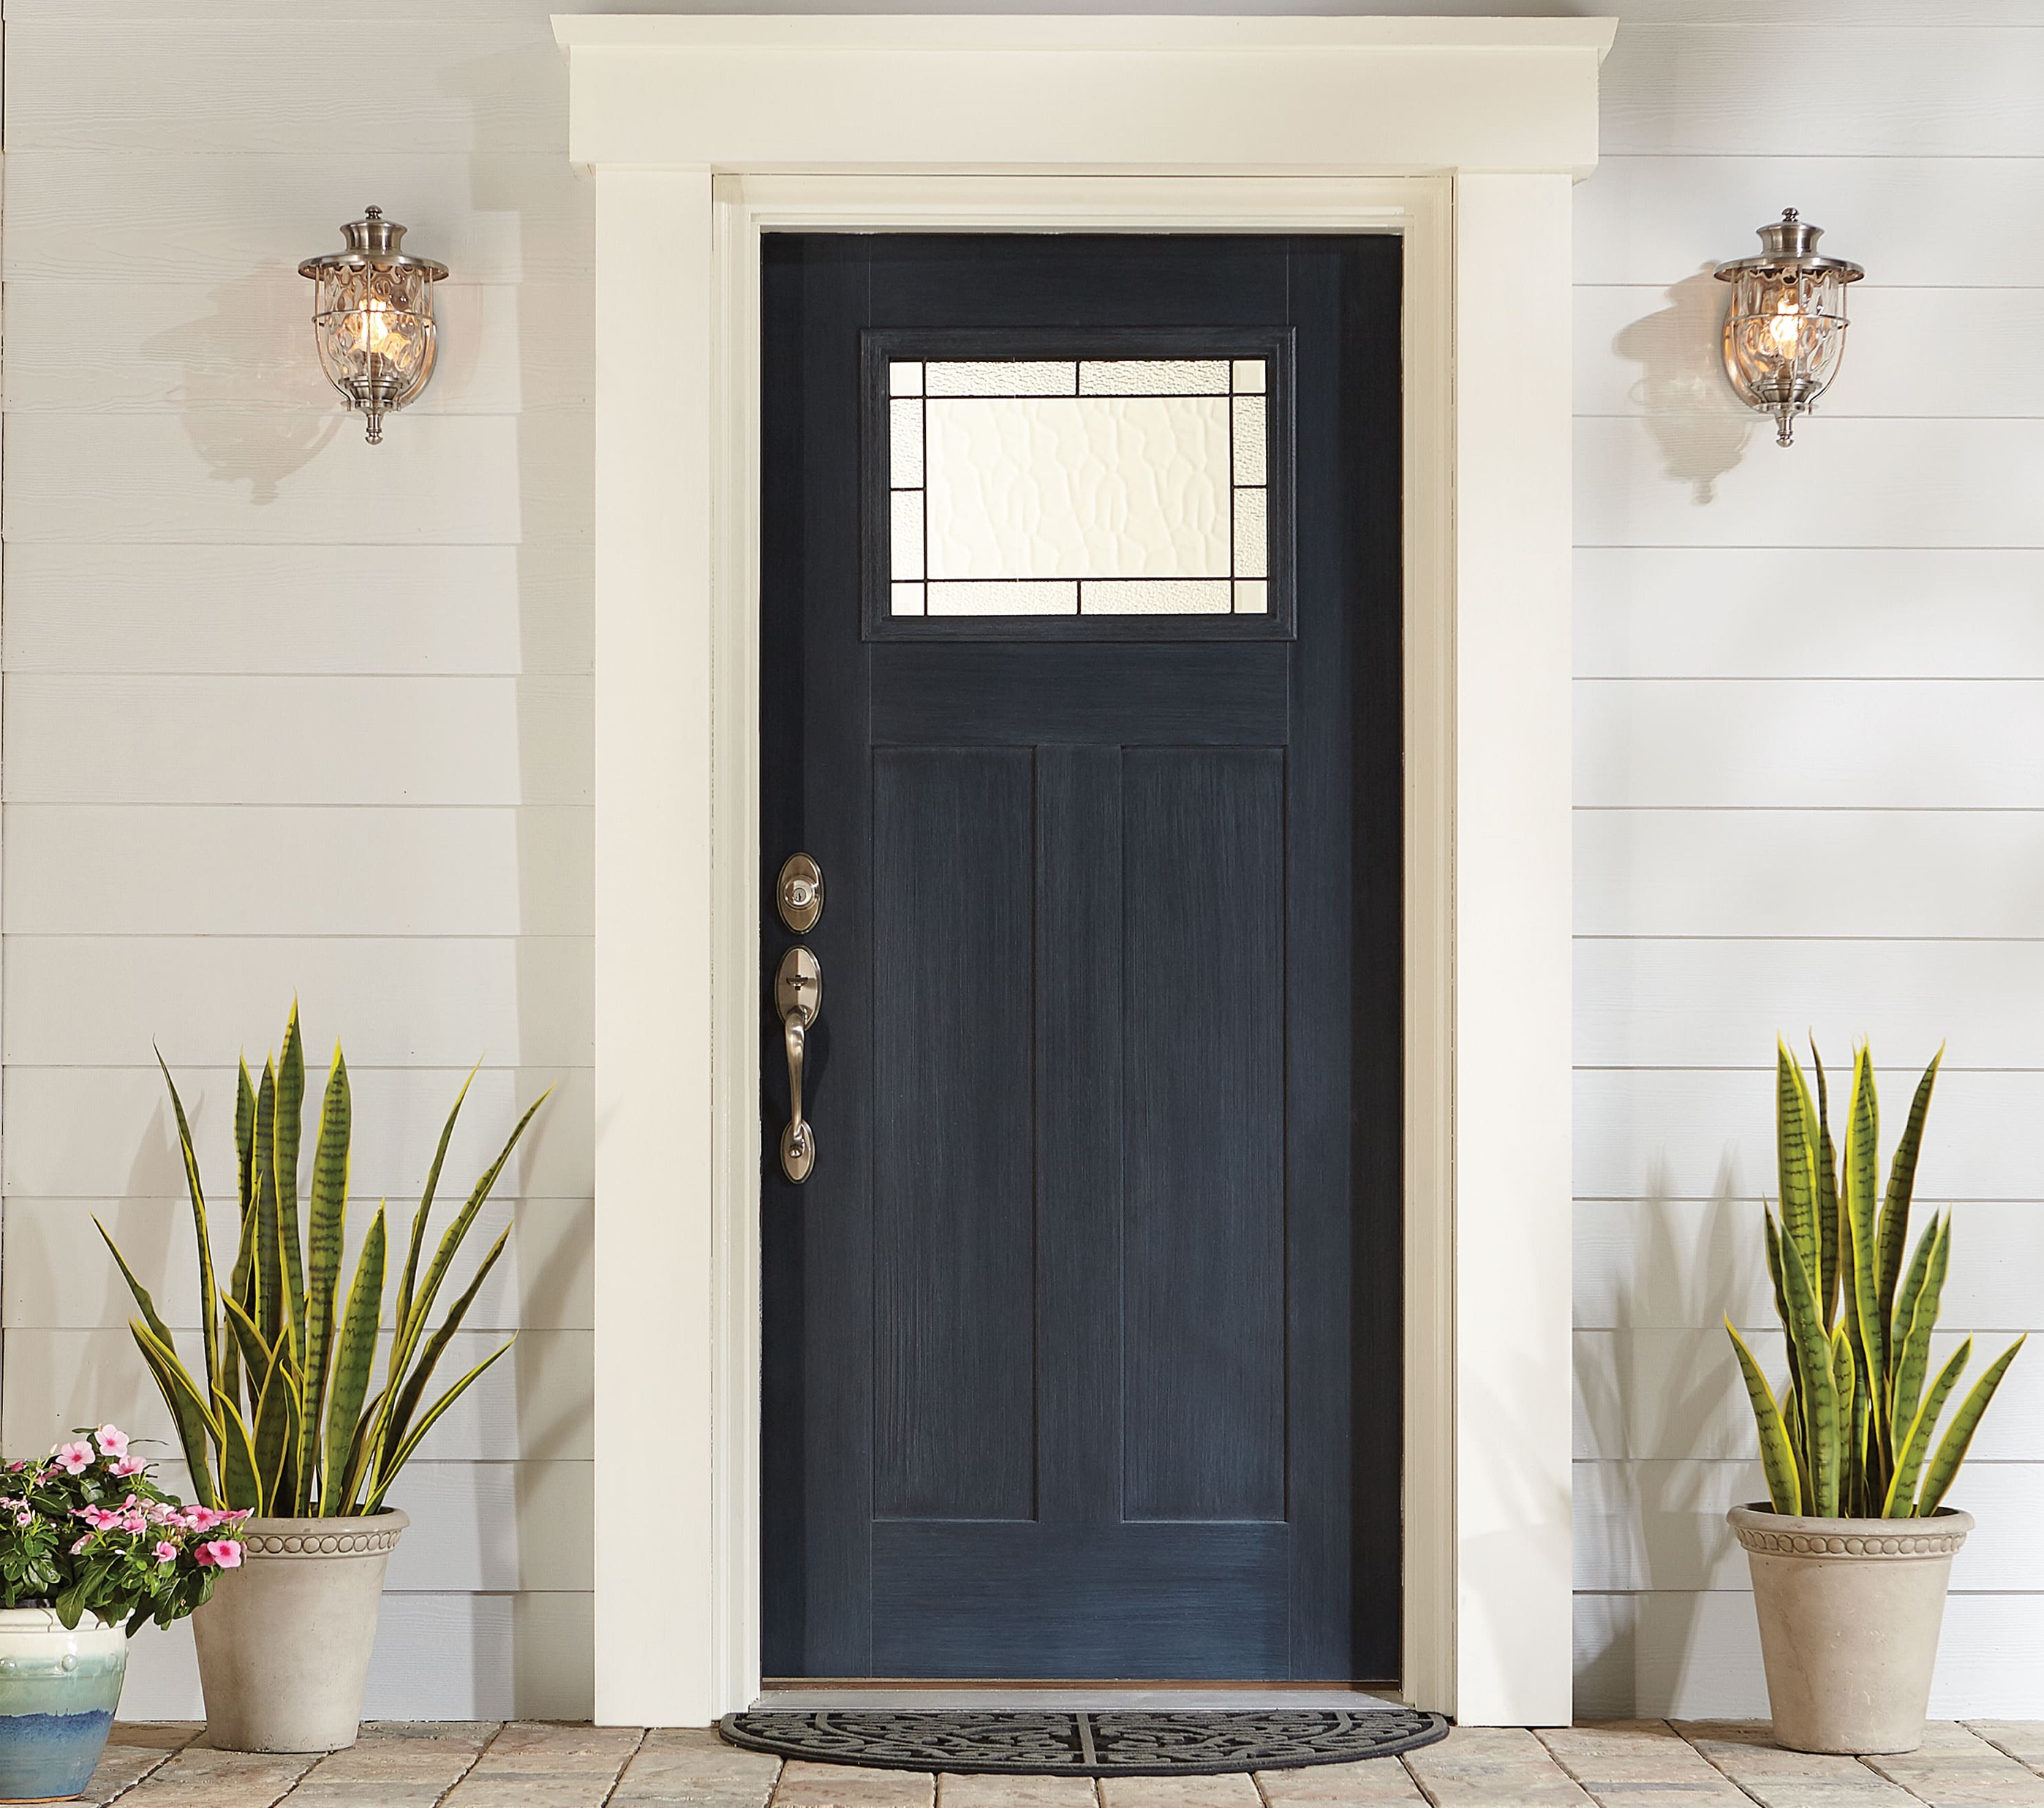
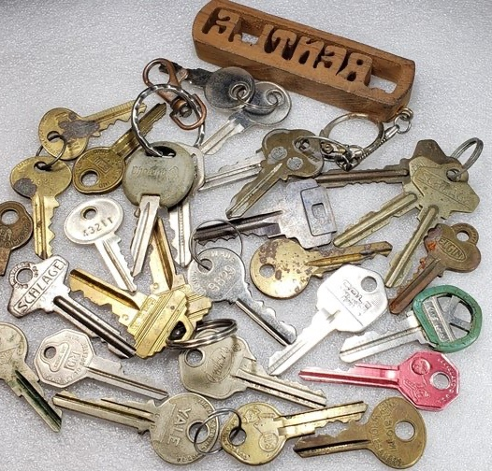

Slide 3
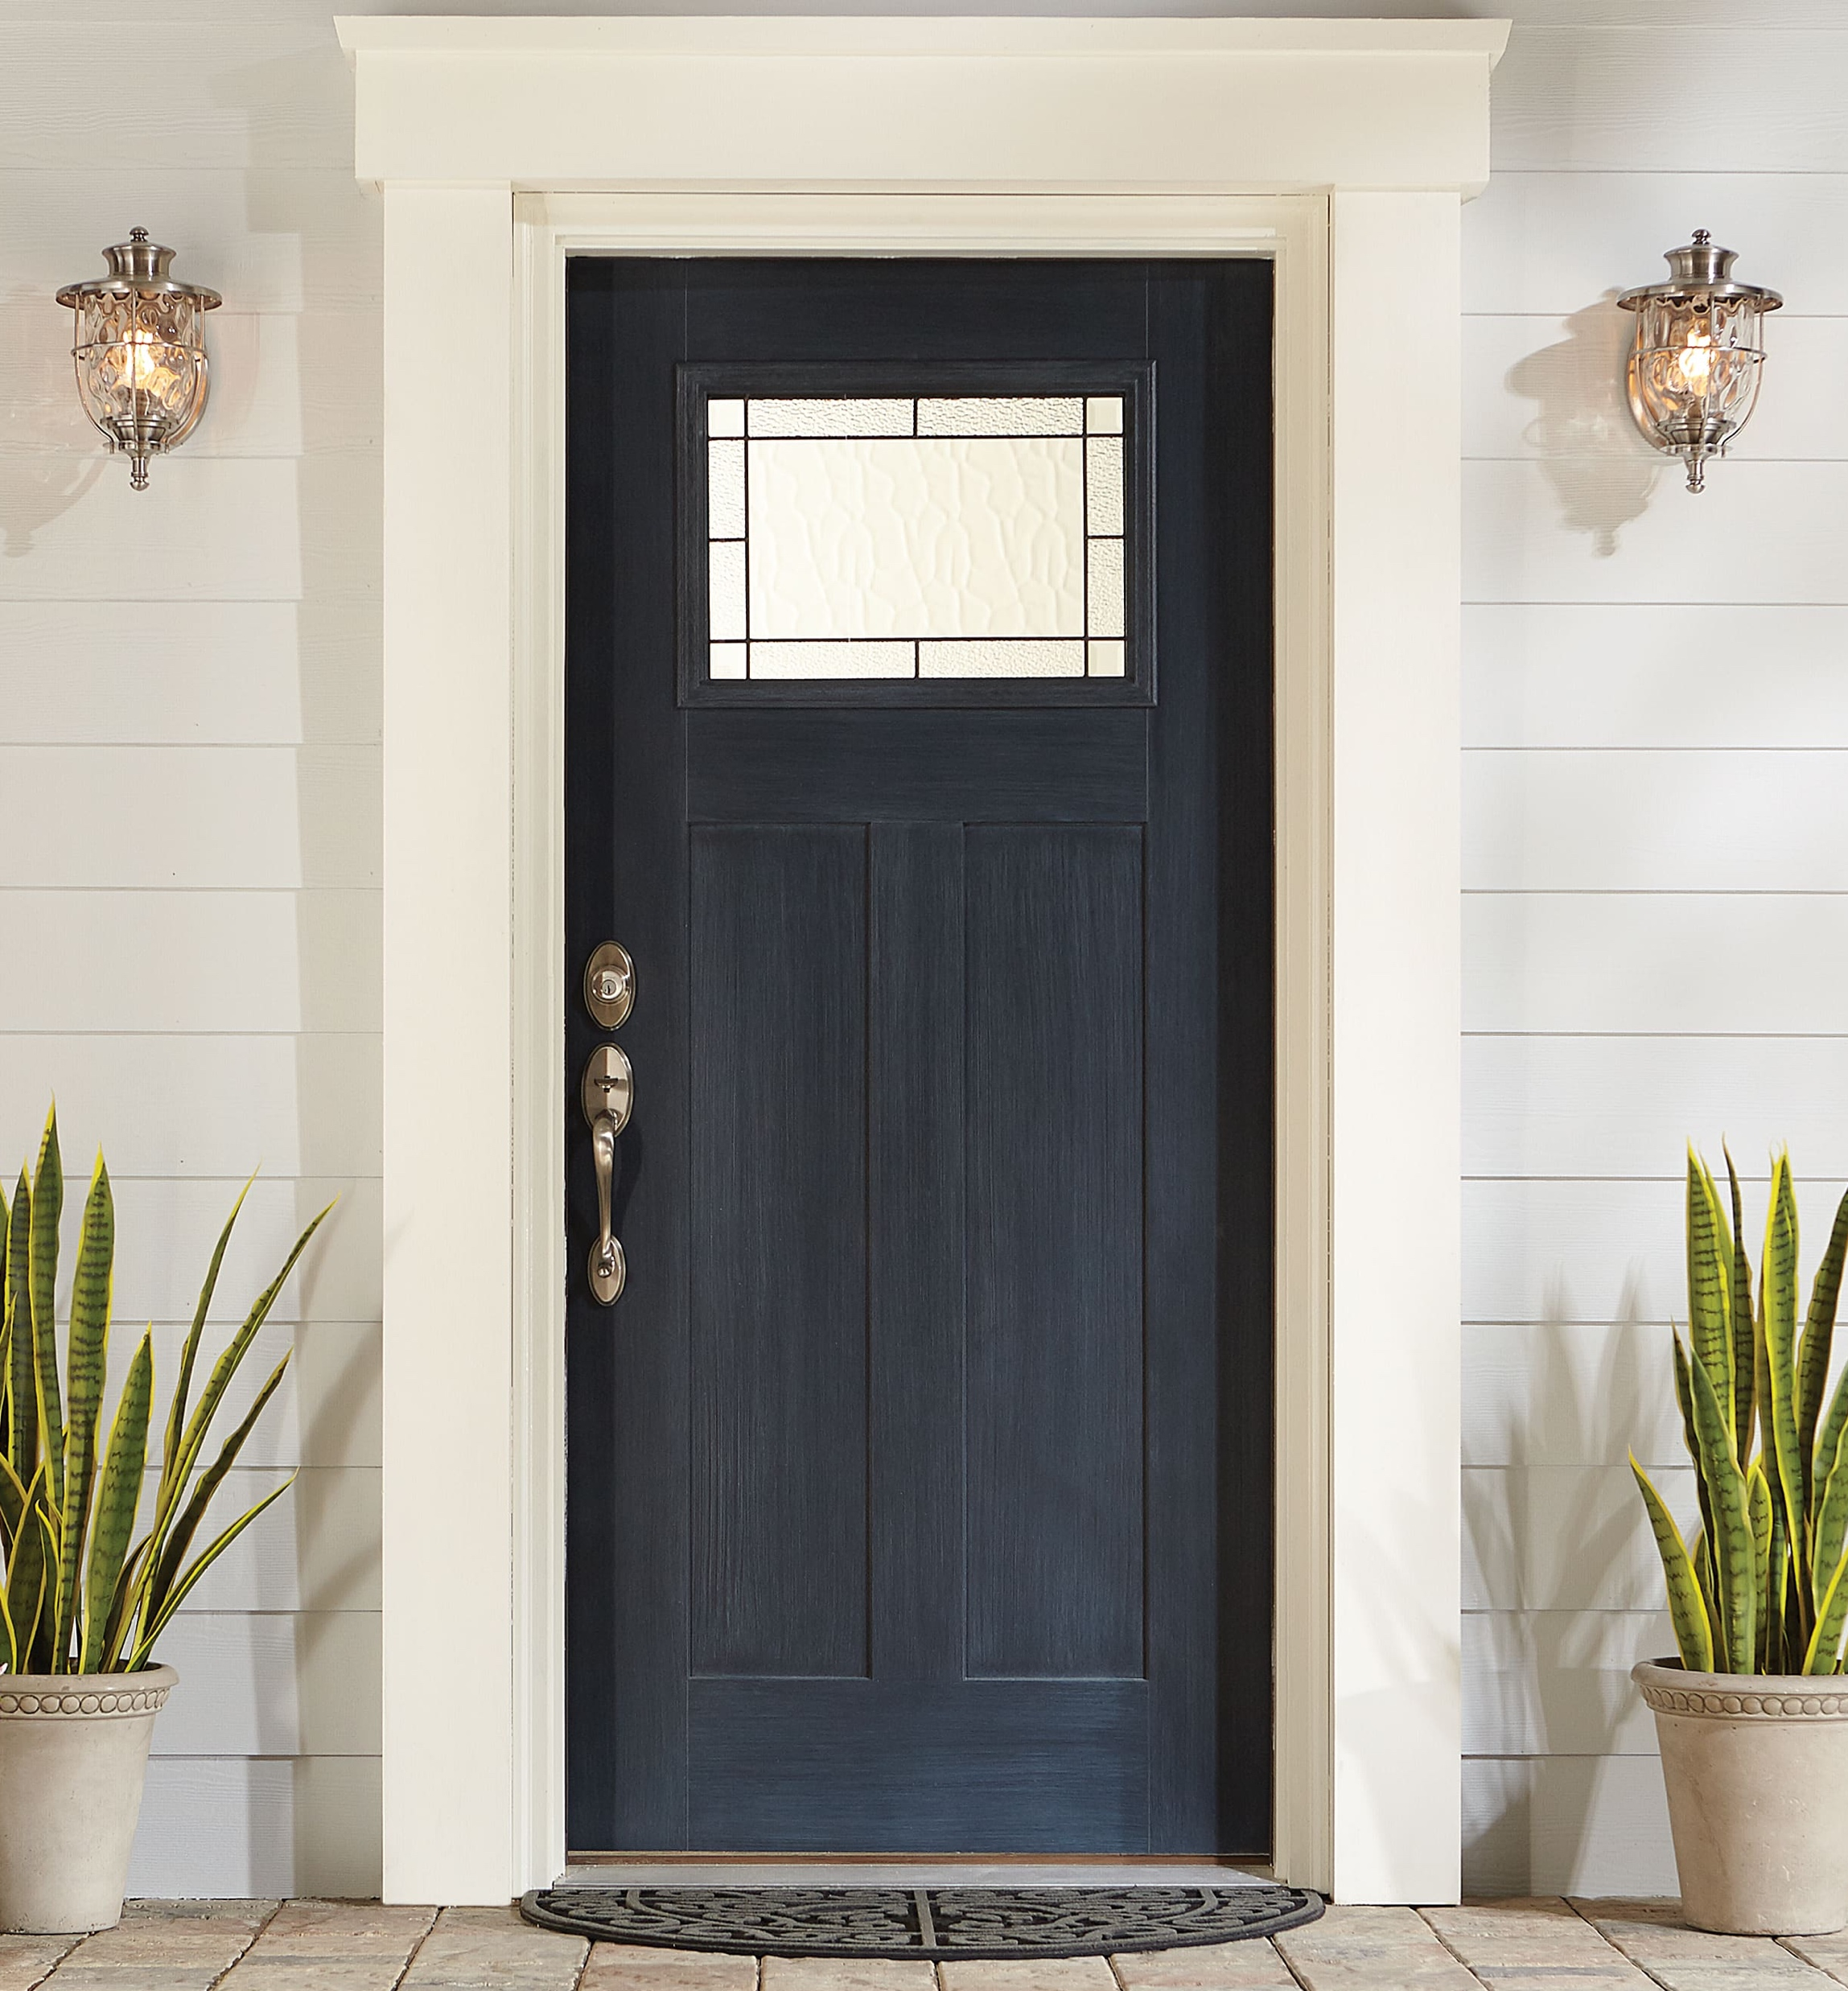
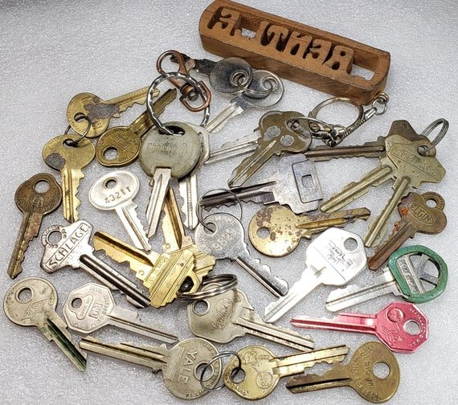
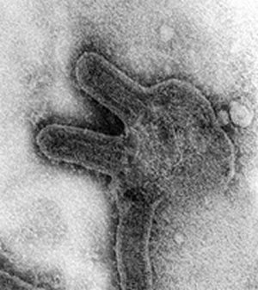
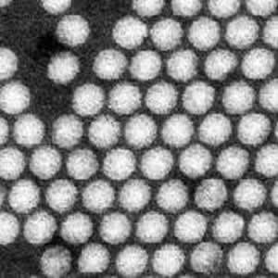
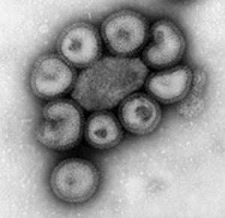
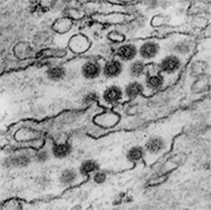
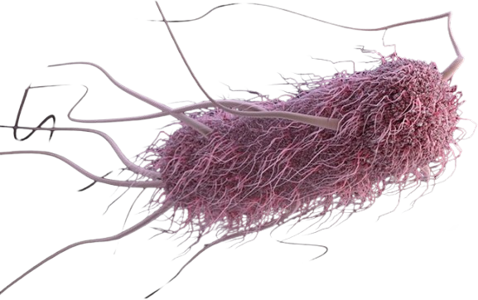
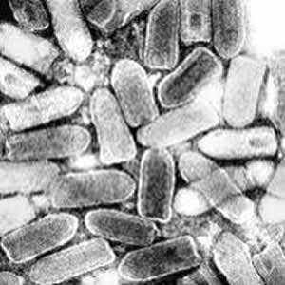
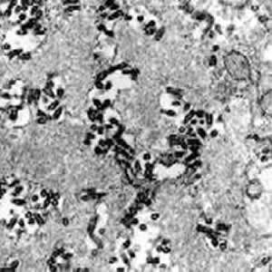
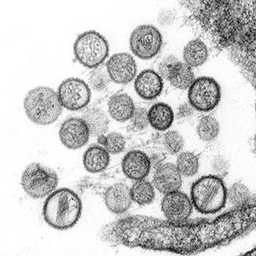
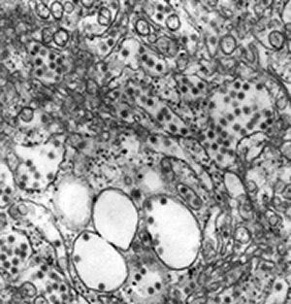
Which virus can kill the bacterium?

Slide 4
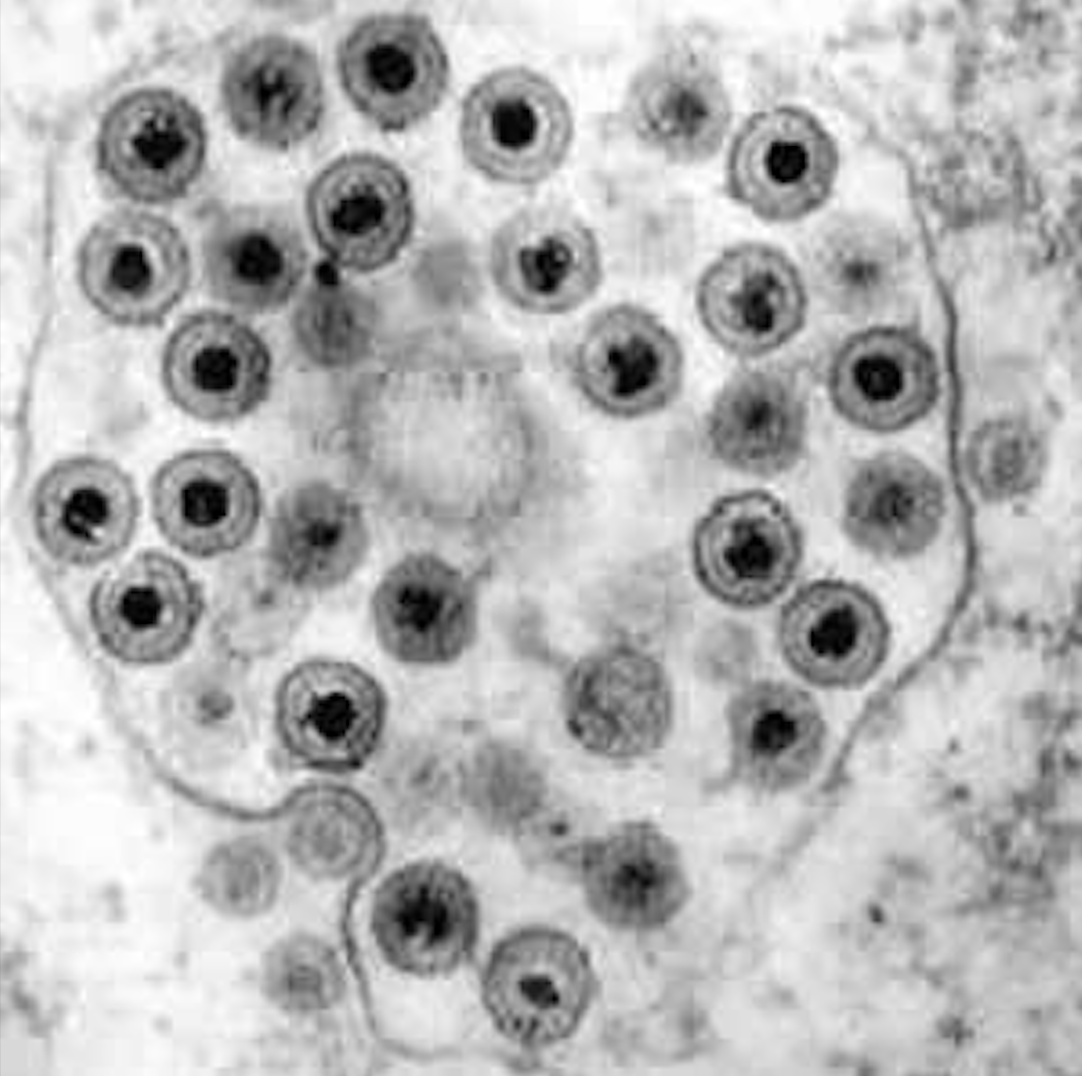
...and thousands more...

Slide 5
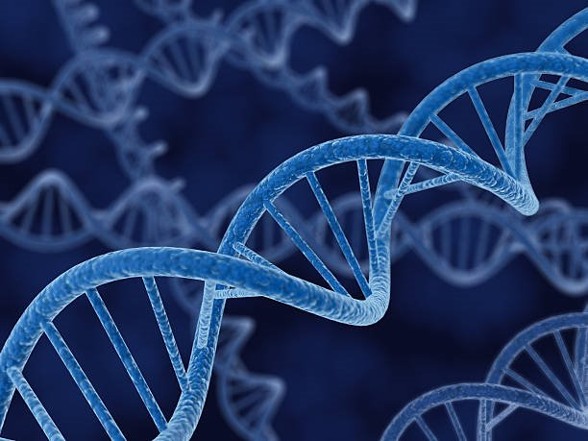
...and thousands more...

Slide 6
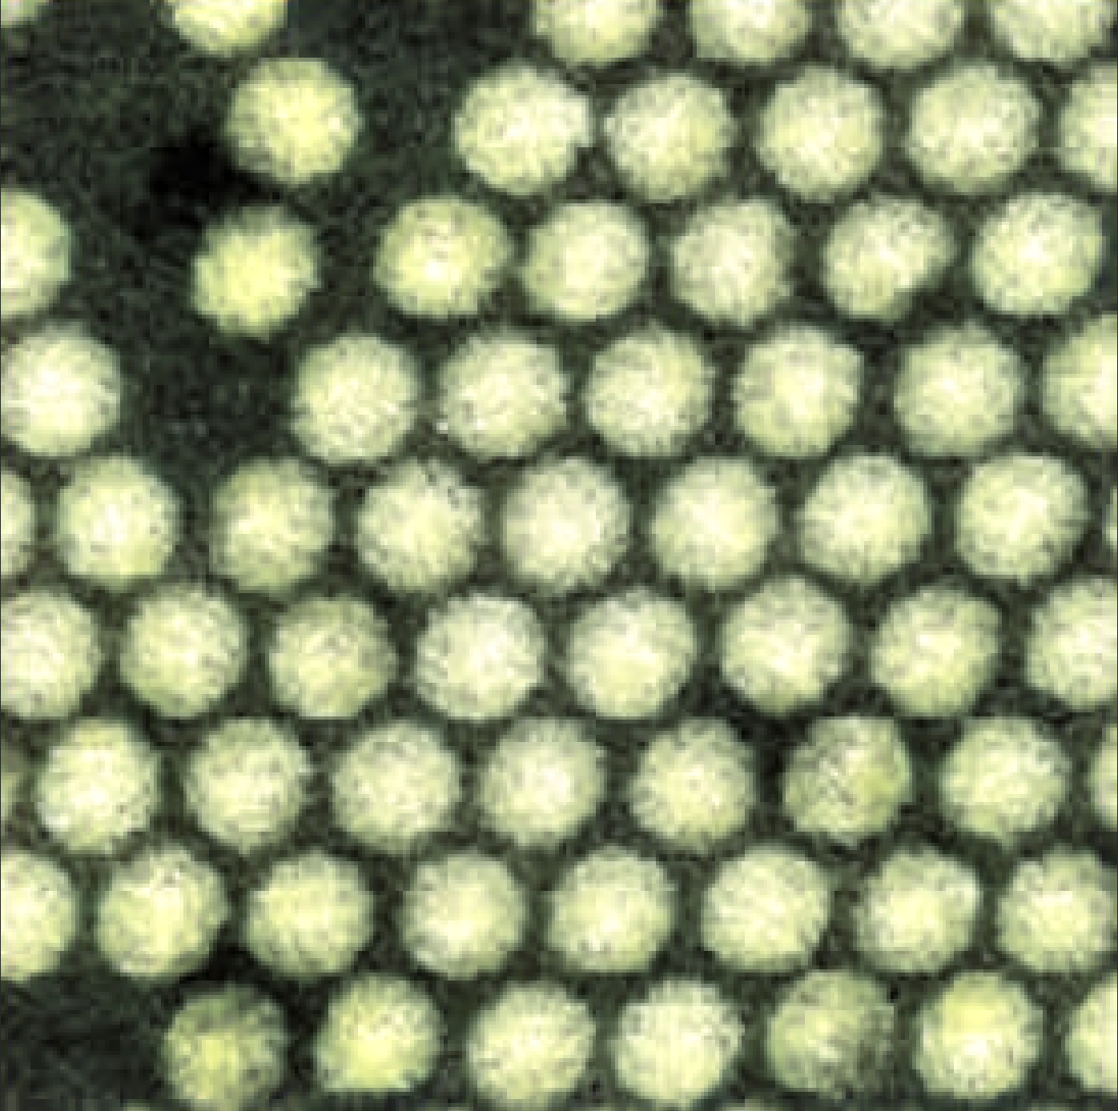
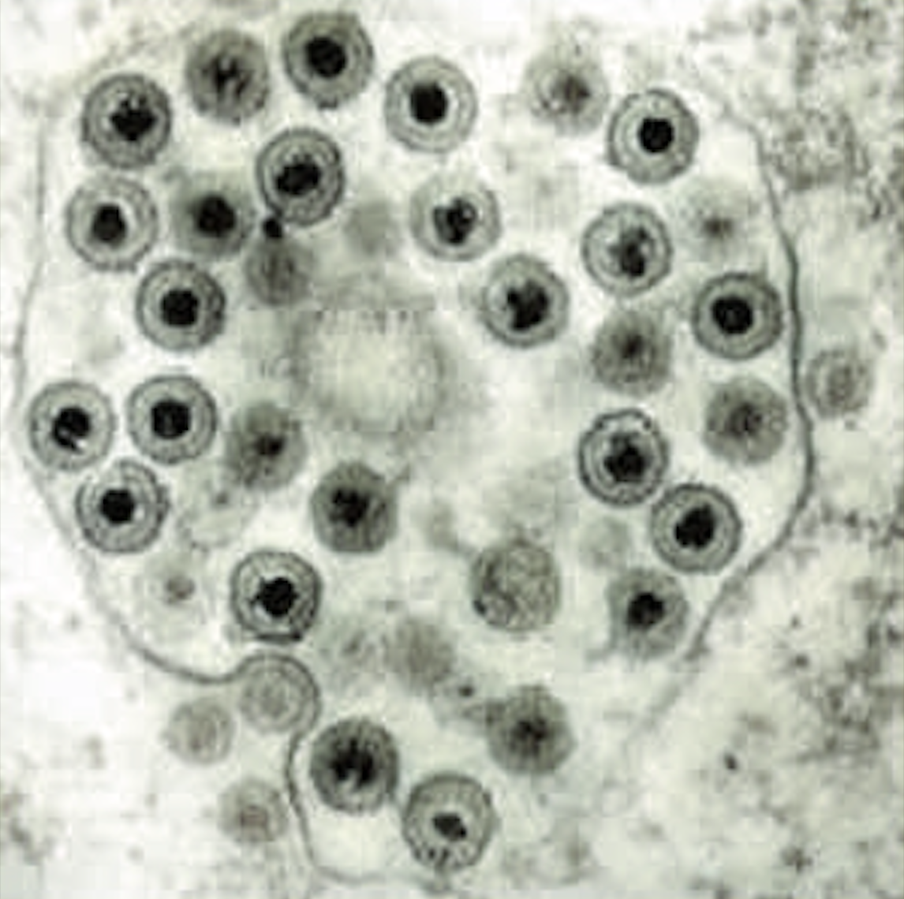
...and thousands more...

Slide 7
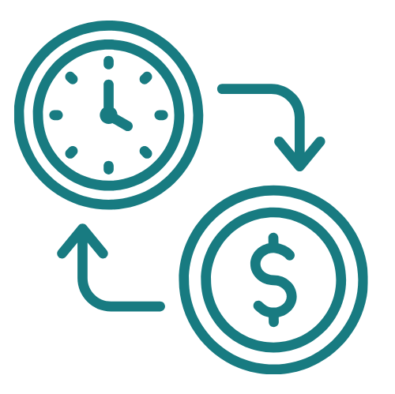
Cost of finding relevant virus
Current method
(try randomly)
Our approach​
(Prefiltering)​
$300K
8 months​​
$10K
2 days​​

Slide 8

Live Demo

Slide 9



Market size phage (virus) therapy
Competitors
$5.4B
$1.2B
2023
2030
Notes:
- phageAI

Slide 10







Pricing & Potential Customers
5 DNA sequences
Limited phage library
Basic ML insights
Basic Plan $500/month
$1560k
20 DNA sequences
Expanded phage library
High-accuracy insights
Email support
Pro Plan
$1.500/month
$780k
$150k
Unlimited sequences
Custom pipelines
Account manager
Enterprise Plan
Custom pricing
2025
2026
2027

Slide 11
Pricing & Potential Customers
5 DNA sequences
Limited phage library
Basic ML insights
Basic Plan $500/month
20 DNA sequences
Expanded phage library
High-accuracy insights
Email support
CEO/Founder
Abdullah Hanif
ML/AI Expert
Dr. Oliver Köhn
Pro Plan
$1.500/month
Unlimited sequences
Custom pipelines
Account manager
Enterprise Plan
Custom pricing

